Slide 1
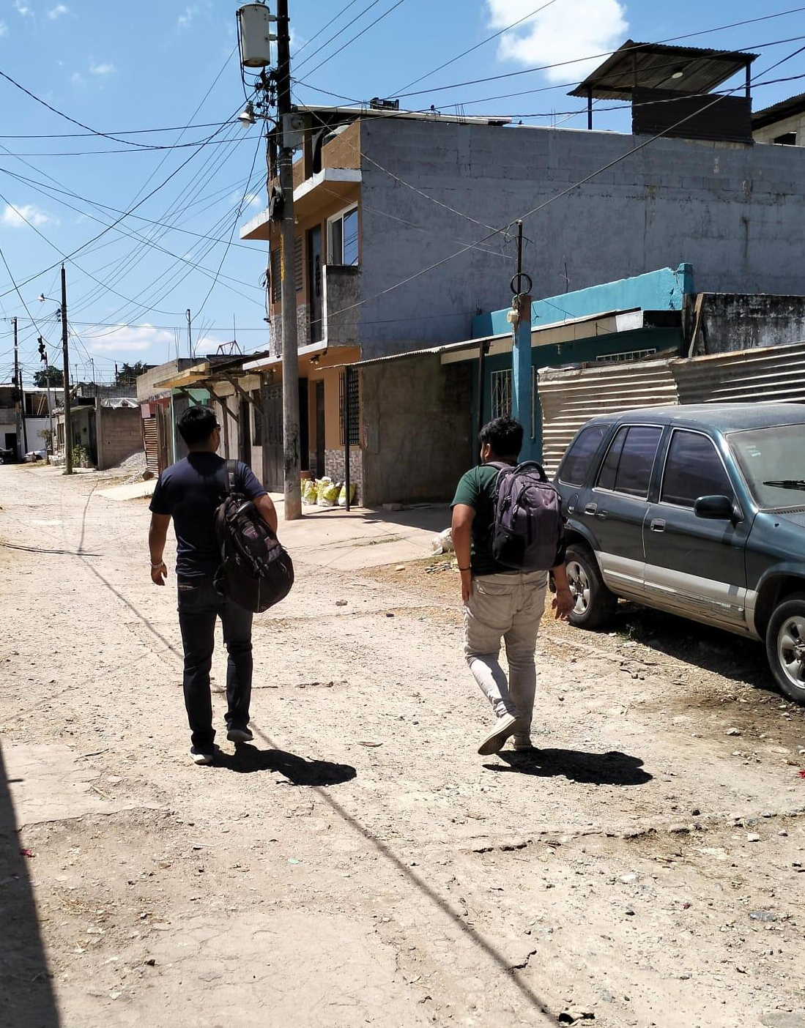
Regional Workshop to exchange experiences in the strategy for continuous quality improvement in the use of rapid tests (RTCQI).
Quality management in rapid HIV testing
at the community level Panama August 2024

Slide 2
Package of
combination HIV prevention
in MSM population
Condoms and lubricant
Pre y post counseling, focuse to risk reduction for HIV and STI
HIV reactive cases
HIV and syphilis screening
Confirmatory HIV tst
Linkage to ART clinic
Assisted Partner Notification
Informative material about HIV, STI
PrEP and PEP
Consultancies
legal

Slide 3
Promoting and valuing community participation and Developing epidemiological surveillance programs.
Article 15 of the HIV Law (1)
Article 13 of the Regulations (2)
Guiding principle and strategic actions of the HIV Public Policy (3)
Congress of the Republic of Guatemala. Ley General para el combate del virus de Inmuno Deficiencia Humana -VIH- y del Síndrome de Inmuno Deficiencia Adquirida -SIDA- y de la promoción, protección y defensa de los derechos humanos ante el VIH/SIDA, Decreto No. 27-2000. 2000. Guatemala
Executive Branch of Guatemala. Reglamento de la Ley General para el Combate del Virus de Inmuno Deficiencia Humana -VIH- y del Síndrome de Inmuno Deficiencia Adquirida -SIDA- y de la Promoción, Protección y Defensa de los Derechos Humanos ante el VIH/SIDA : Acuerdo No. 317-2002. 2002. Guatemala.
Ministry of Public Health and Social Assistance. National Program for the Prevention and Control of STIs, HIV and AIDSPublic Policy Agreement No. 638-2005: Regarding the prevention of sexually transmitted infections - STIs - and the response to the epidemic of Acquired Immune Deficiency Syndrome - AIDS-. 2006. Guatemala

Slide 4
Field health promoter training
Algorithm for diagnosis
With support from the National Health Laboratory
Diagnostic algorithm
Results reading and report
Biosafety
Quality
HIV and STI unity
Virology section

Slide 5
Other areas of training for field health promoter
Legal context of HIV.
Emotional crisis care in the delivery of reactive cases.
Quality of information
Pre- and post-test orientation
STI General
Process of linkage to the UAI
Combination prevention interventions (PrEP, PEP, self-testing)

Slide 6
Graph 1: Report of HIV tests carried out in clinic and in the field Colectivo Amigos Contra el Sida-CAS January 02 to July 31, 2024
ART clinic linkage and linkage effectiveness
HIV Testing
Reactive HIV
N=10,937
N=256
138
N=176
113
15,000
150
120
100
80
60
40
20
0
118
10,000
6,924
100
63
5,000
4,013
50
0
63% 37%
1.7
3.4
53% 82%
0
HIV Screening
%
HIV reactive Reactivity
Field promoters / 09 Municipalities intervened VICITS CAS Clinic, Guatemala City
Linked and confirmed in ART
Effectiveness
Field Promoters / 09 Municipalities... VICITS CAS Clinic, Guatemala City
Field promoters / 09 Municipalities intervened VICITS CAS Clinic, city of Guatemala
Fuente: DHIS2

Slide 7
Multisectoral coordination with:
The community
The Ministry of Health
CDC implementers in Guatemala.
Global Fund
OPS
Onusida
Meeting places of the population
With the Academy

Slide 8
Increased access to hidden population
Peers support to provide differentiated, relevant and person-centered services.
Word of mouth information dissemination in the community
Active surveillance from the community for reporting to the Epidemiology Department (4)
Accurate and complete data collection for reporting through SIGSA (5)
Benefits
of the HIV test
at the community level
Ministry of Public Health and Social Assistance of Guatemala, Department of Epidemiology. Protocols for Epidemiological Surveillance of Sexually Transmitted Infections and Advanced HIV/HIV. 2018. Guatemala
Ministry of Public Health and Social Assistance of Guatemala. Manual de Organización y Funciones de la Unidad del Sistema de Información Gerencial en Salud - SIGSA-.2015. Guatemala

Slide 9
Regional Workshop to exchange experiences in the strategy for continuous quality improvement in the use of rapid tests (RTCQI).
Quality management in rapid HIV testing
at the community level

